Slide 1
Capturing Non-manual Features of Indian Sign Language and Converting it into Text
PIP4004 University Project
Final Viva-Voca
Batch Number: 8CSG-G9
Roll Number | Student Name
20211CSG0048 | MAMATHA S
20211CSG0006 | NITHYA T M
20211CSG0028 | NARMADA RADHIKA J S
20211CSG0025 | PRACHI
Under the Supervision of,
Dr. Leelambika K V
School of Computer Science and Engineering
Presidency University
Name of the Program: B.Tech​
Name of the HoD: Dr. Saira Banu Atham
​
Name of the Program Project Coordinator: Dr. Manjula H M
​
Name of the School Project Coordinators: Dr. Sampath A K / Dr. Abdul Khadar A / Mr. Md Ziaur Rahman​

Slide 2
Introduction
Individuals with hearing or speech impairments face daily communication challenges due to limited public understanding of sign language and gaps in speech recognition technology. Current solutions lack a unified, real-time system supporting both groups. This project aims to develop an inclusive platform that integrates real-time ASL recognition using YOLO v8 and speech-to-text conversion, enabling seamless communication and enhancing accessibility.

Slide 3
Literature Review
Paper Title | Journal/Conference (Year) | Advantages | Limitations
1.SIGNFORMER: Deep Vision Transformer for Sign Language Recognition | ACM International Conference on Multimedia (2022) | Transformer-based model offering superior context awareness and accuracy. | Requires substantial training time and large datasets.
2.Helping Hearing-Impaired in Emergency Situations a deep learning based approach | IEEE Sensors Journal (2020) | Real-time deep learning-based emergency gesture detection; practical utility. | Supports only predefined gestures; relies on specific hardware.
3.Hybrid InceptionNet Based Enhanced Architecture for Isolated Sign Language Recognition | Springer, Neural Computing and Applications (2021) | Enhances accuracy with attention mechanisms and InceptionNet architecture. | Restricted to isolated signs; not suited for continuous gesture recognition.
4.IDF-Sign: Addressing Inconsistent Depth Features for Dynamic Sign Word Recognition | IEEE Transactions on Multimedia (2022) | Robust 3D CNN model that addresses inconsistent depth features in dynamic signs. | High computational cost; requires depth sensing hardware.
5.Multi-Semantic Discriminative Feature Learning for Sign Gesture Recognition Using Hybrid Deep Neural Architecture | IEEE Access (2022) | Integrates multi-level semantic features using a hybrid CNN-RNN model. | Resource-intensive; susceptible to overfitting on limited data.

Slide 4
Existing method Drawback
Existing method:
In existing systems for sign language recognition and speech-to-text conversion, older deep learning models like Convolutional Neural Networks (CNNs) have been used extensively. For sign language recognition, CNN-based models are typically employed for image classification tasks where static images of hand gestures or sign language symbols are processed. These models are trained on large datasets like the ASL dataset, learning to map hand gestures to corresponding text. While CNNs are efficient at processing visual data, they struggle with dynamic sign language, where continuous movements or varied signing styles are involved.
Drawbacks:
1.Limited Handling of Dynamic Gestures
2.Insufficient Accuracy for Complex Gestures
3.Dependence on Good Lighting and Image Quality
4. Cost Implications

Slide 5
Objectives
Creating an accurate sign language recognition system by leveraging the ASL dataset and YOLO v8 model to translate live sign language gestures into text in real time.
Integrating a speech-to-text module that uses speech recognition libraries to convert spoken words into text, aiding individuals with speech impairments.
Developing a user-friendly platform with Flask that combines both sign language recognition and speech-to-text functionalities for smooth, real-time communication.
Enhancing communication accessibility for users with hearing and speech challenges across key sectors such as education, healthcare, and public services.
Promoting inclusivity by offering a comprehensive solution that accommodates various communication preferences, encouraging interaction and mutual understanding among diverse user groups.

Slide 6
Model Architecture
The application initializes key components like the UI, YOLO detection, and MediaPipe hand tracking. Users log in to access a dashboard where they choose between speech or sign language input. Speech is processed via ASR (e.g., Google Speech API), while sign language uses YOLO for hand detection, MediaPipe for landmark extraction, and a Keras model for gesture classification. The recognized text is displayed on the interface, and the session ends by securely releasing resources. This ensures seamless communication between speech and sign language using AI and computer vision.

Slide 7
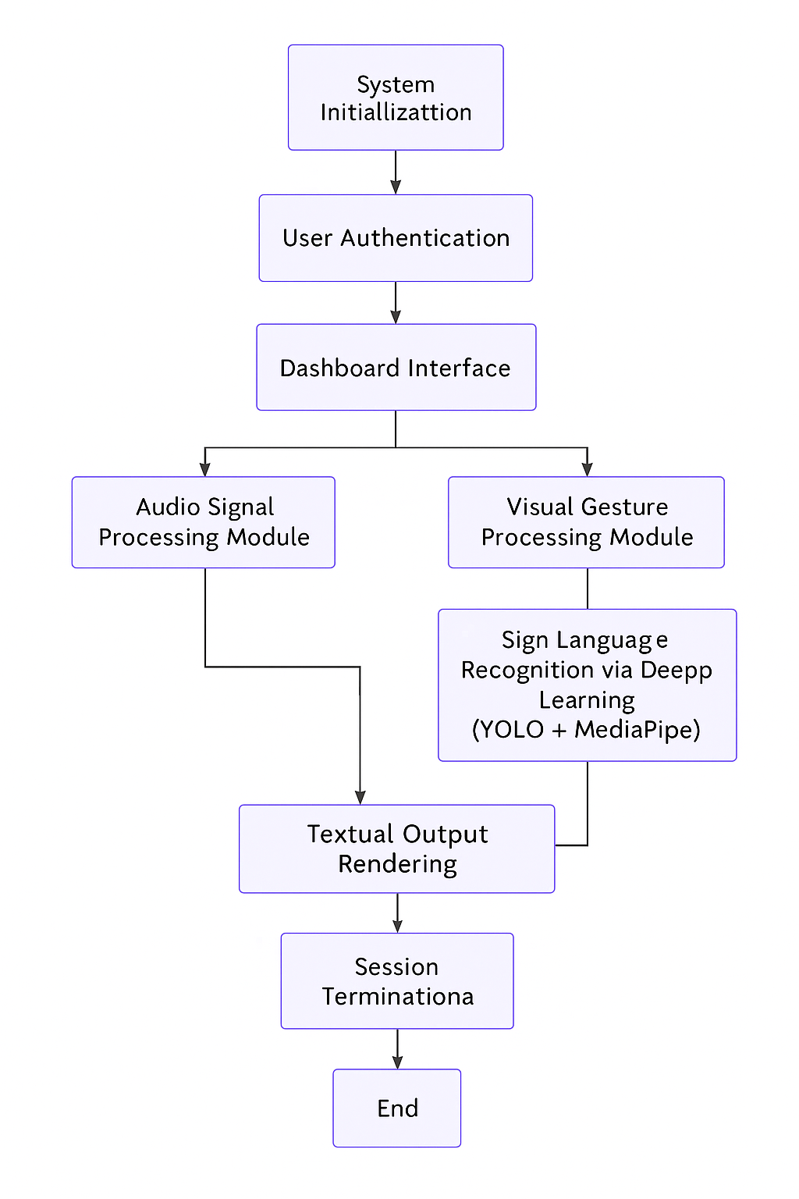
Architecture

Slide 8
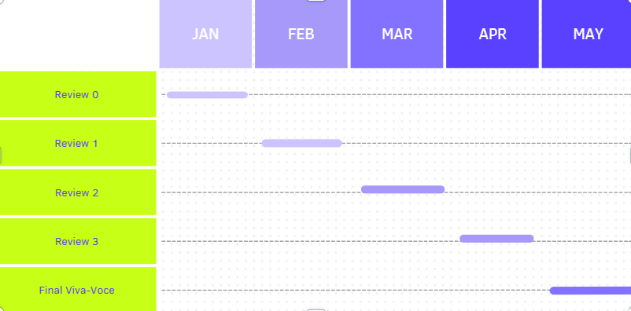
Timeline of Project

Slide 9
Conclusion
The project "Capturing Non-manual Features of Indian Sign Language and Converting it into Text" combines YOLO v8-based real-time sign language recognition with speech-to-text conversion using modern libraries. Integrated via Flask, the system offers a seamless, accurate, and user-friendly communication solution, addressing gaps in traditional systems. It holds potential for broad applications in education, healthcare, public services, and customer support, enhancing accessibility for hearing and speech-impaired individuals.
Looking forward, future advancements could include multi-language support, enhanced gesture detection through advanced neural networks, and integration with wearable technology to increase portability and usability. Overall, this project represents an important step towards creating a more inclusive and accessible digital ecosystem, enabling effortless communication for all individuals.

Slide 10
References
Papastratis, Ioannis, et al. "Artificial Intelligence Technologies for Sign Language." Frontiers in Robotics and AI, 2021.
Madahana, M., et al. "A Proposed Artificial Intelligence-Based Real-Time Speech-to-Text to Sign Language Translator for South African Official Languages for the COVID-19 Era and Beyond: In Pursuit of Solutions for the Hearing Impaired." South African Journal of Communication Disorders, 2022.
Roy, Parsheeta, et al. "American Sign Language Video to Text Translation." arXiv preprint arXiv:2402.07255, 2024.
Zuo, Ronglai, et al. "Towards Online Sign Language Recognition and Translation." arXiv preprint arXiv:2401.05336, 2024.
G, Velmathi, and Kaushal Goyal. "Indian Sign Language Recognition Using Mediapipe Holistic." arXiv preprint arXiv:2304.10256, 2023.

Slide 11
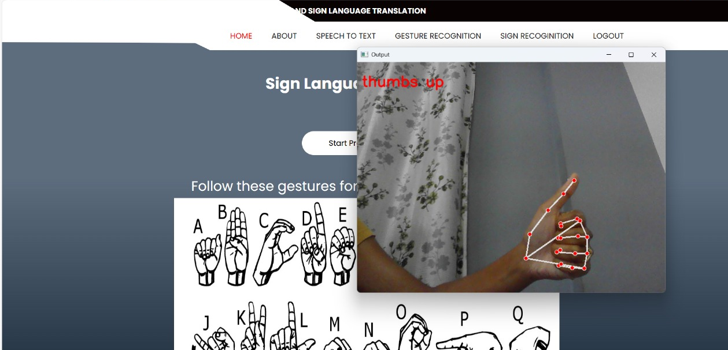
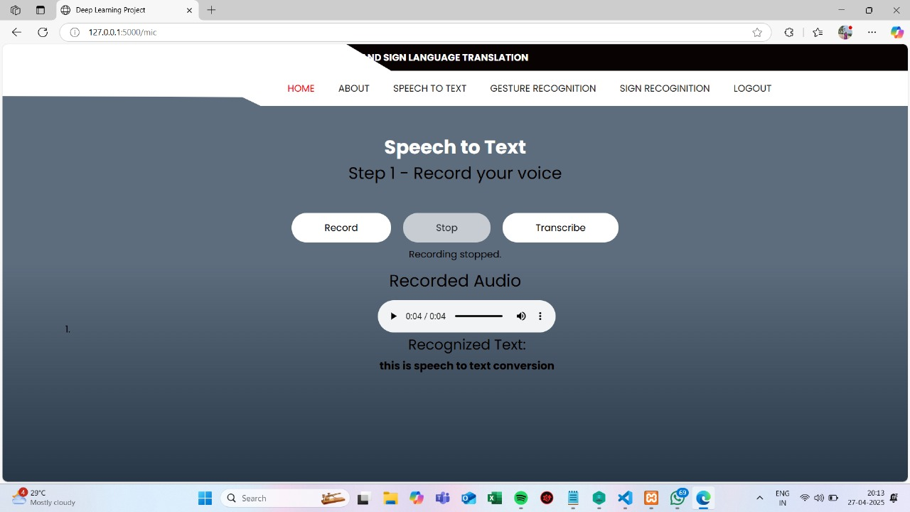
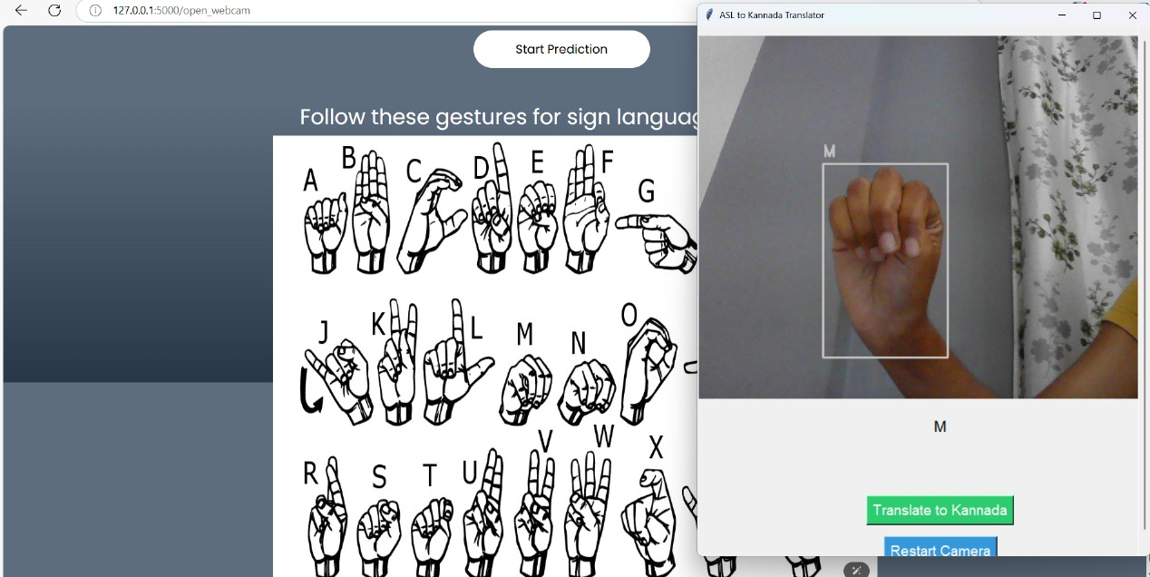
Result & Outcomes Obtained

Slide 12

Project work mapping with SDG
SDG 4: Quality Education
Promotes inclusive learning, especially for individuals with hearing impairments.
SDG 8: Decent Work and Economic Growth
Empowers people with communication disabilities using assistive technologies.
SDG 9: Industry, Innovation, and Infrastructure
Utilizes advanced technologies like YOLOv8, real-time video processing, and multilingual translation.

Slide 13
Project work mapping with SDG
SDG 10: Reduced Inequalities
Bridges communication gaps for the hearing-impaired community.
SDG 11: Sustainable Cities and Communities
Enhances inclusivity in urban environments by supporting real-time communication for the hearing-impaired.
SDG 16: Peace, Justice, and Strong Institutions
Upholds the rights of people with disabilities through inclusive communication access.
SDG 17: Partnerships for the Goals
Encourages collaboration among academic institutions, NGOs, and government agencies focused on accessibility and assistive tech.

Slide 14
GitHub link for the project​
Link:
https://github.com/mamathas18/sign-language-translation.git

Slide 15
Thank You

